Slide 1

AI NI Academy 2
An introduction to Microsoft ML Studio

Slide 2




Introductions
Jake
Chloe

Slide 3
This Evening
Our Second Workshop
During this workshop we will be using Microsoft ML Studio to take you through the basics of sentiment analysis.
Make sure that you are signed up to ML Studio and follow along with these intro slides!
Workshop Contents
Introduction to Machine Learning
What is Sentiment Analysis?
Basics of ML Studio
Analysis of Sentiment on a Product Reviews Dataset
Model Creation
Model Predictions
Model Deployment

Slide 4
1.
Machine Learning Recap

Slide 5

ANI AGI ASI

Slide 6
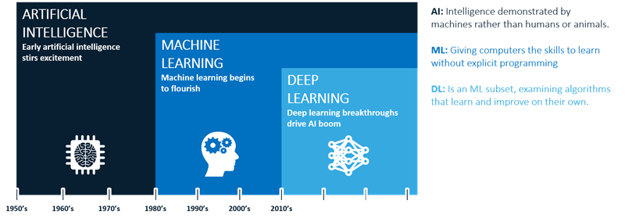
The Spectrum

Slide 7
Some Definitions
Regression
Regression is a supervised learning method. It is used to predict values with a continuous range e.g. 0-100.
When predicting a continuous value like the price of a house or a stock price we can’t use an accuracy metric, so we have to use what is known as the mean squared error (MSE).
Classification
Multi-class classification is a classification task with more than two classes where each label is mutually exclusive.
Binary classification is similar to multi-class classification except that there are only two classes, hence the name binary.
VS

Slide 8
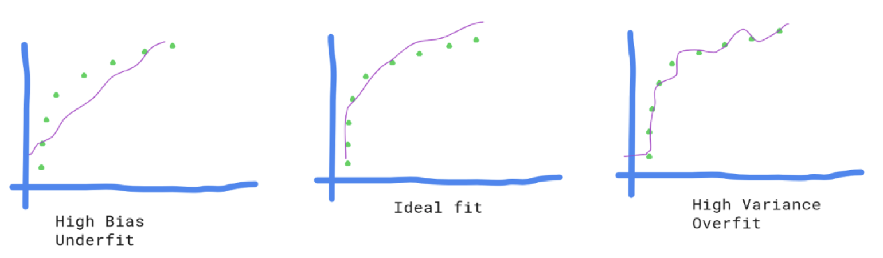
Some Definitions
Underfitting
Due to High Bias
Generalising
Due to Balanced Bias and Variance
Overfitting
Due to High Variance

Slide 9

Feeling Positive Yet?
We will be using ML Studio to classify reviews based on their sentiment!

Slide 10




What is Sentiment Analysis?

Slide 11
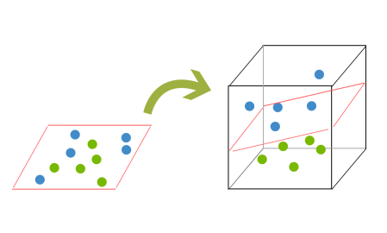
What is a SVM?
Support Vector Machine is a supervised machine learning algorithm which can be used for classification or regression problems. This algorithm outputs a hyperplane that it uses to classify data.
We will be using this as one of our algorithms to classify our reviews.

Slide 12
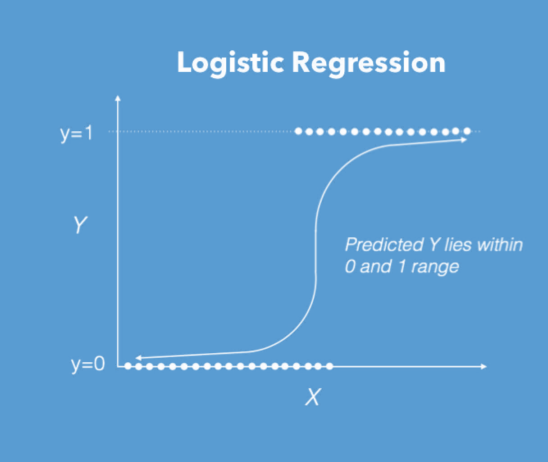
What is Logistic Regression?
Logistic Regression is a machine learning algorithm which is used regression problems. This algorithm takes the data and gives a discrete value between 0 &1 using the sigmoid function. .
We will be using this as one of our algorithms to classify our reviews.

Slide 13
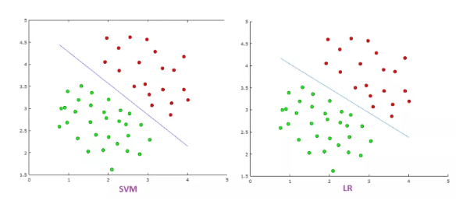
SVM VS Logistic Regression
Notes:
LR is more sensitive to outliers than SVM
SVM tries to maximize the margin between the closest support vectors
SVM tries to find the widest possible separating margin, while Logistic Regression optimizes the log likelihood function, with probabilities modeled by the sigmoid function.
Take Home Message: LR is simpler and less computationally expensive so try it first and then if results aren’t great move on to SVM

Slide 14
F score, Precision and Recall
F Score
The F-beta score can be interpreted as a weighted harmonic mean of the precision and recall, where an F-beta score reaches its best value at 1 and worst score at 0.
Precision
The precision is the ratio
tp / (tp + fp)
where tp is the number of true positives and fp the number of false positives. The precision is intuitively the ability of the classifier to not label a positive sample that is negative.
Recall
The recall is the ratio
tp / (tp + fn)
where tp is the number of true positives and fn the number of false negatives. The recall is intuitively the ability of the classifier to find all the positive samples.

Slide 15
We’re only at the tip of the iceberg! Let’s Dive into Code!

Slide 16


THANKS!
Any questions?
You can find us at:
@JakeYoung2410
@Chloe__Thomp
ai-ni-group.slack.com

